Slide 1
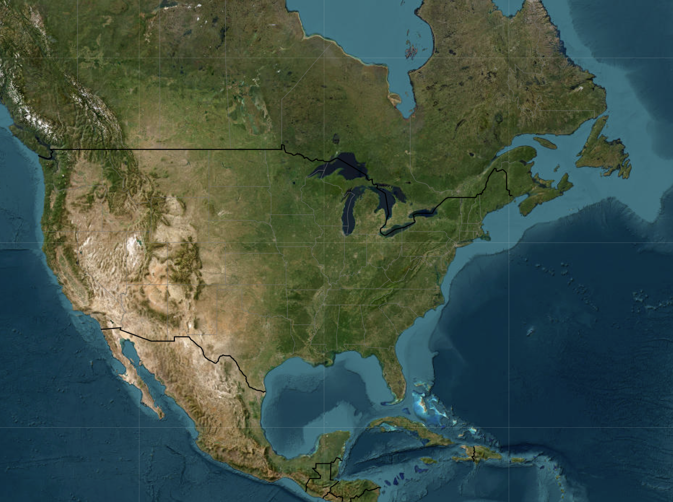
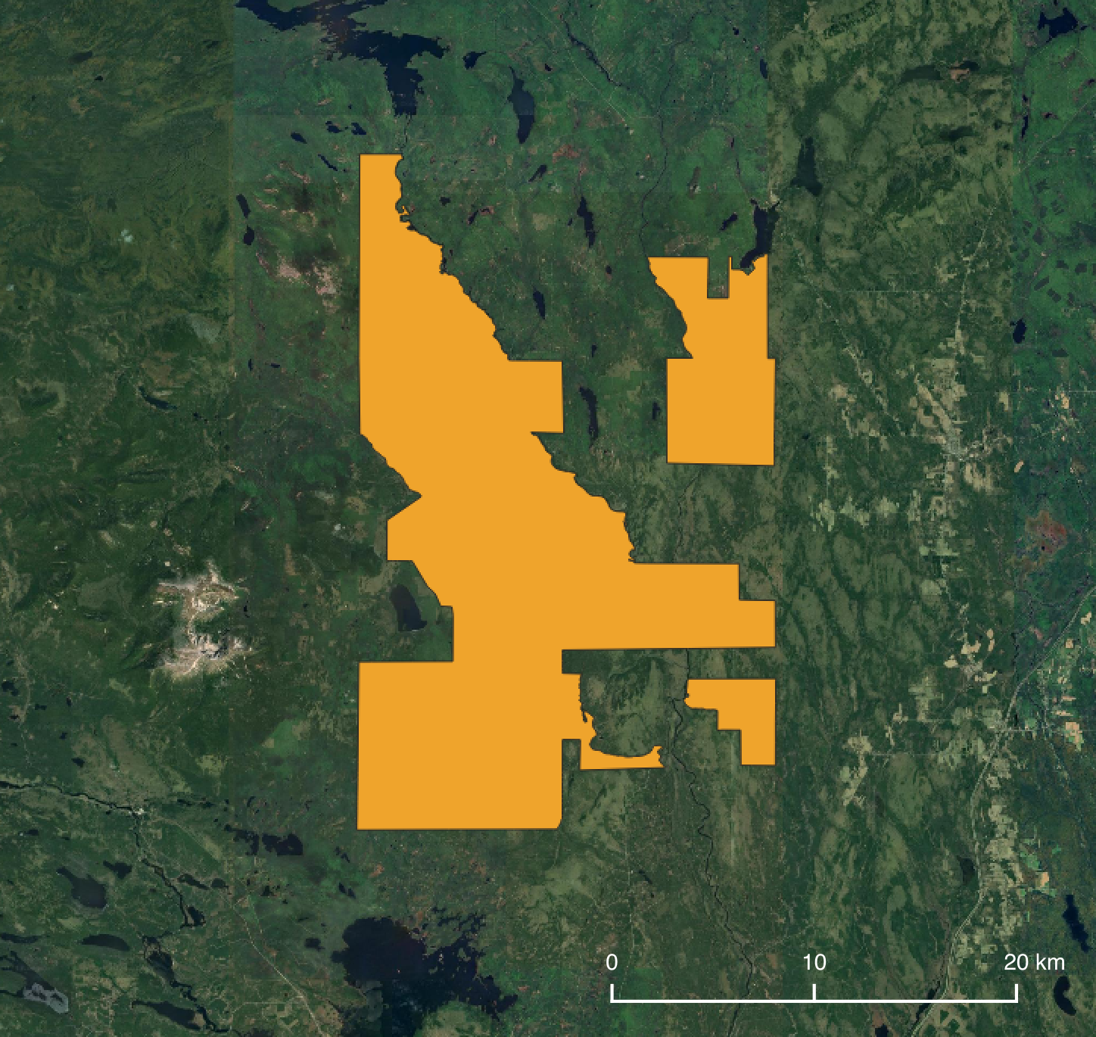

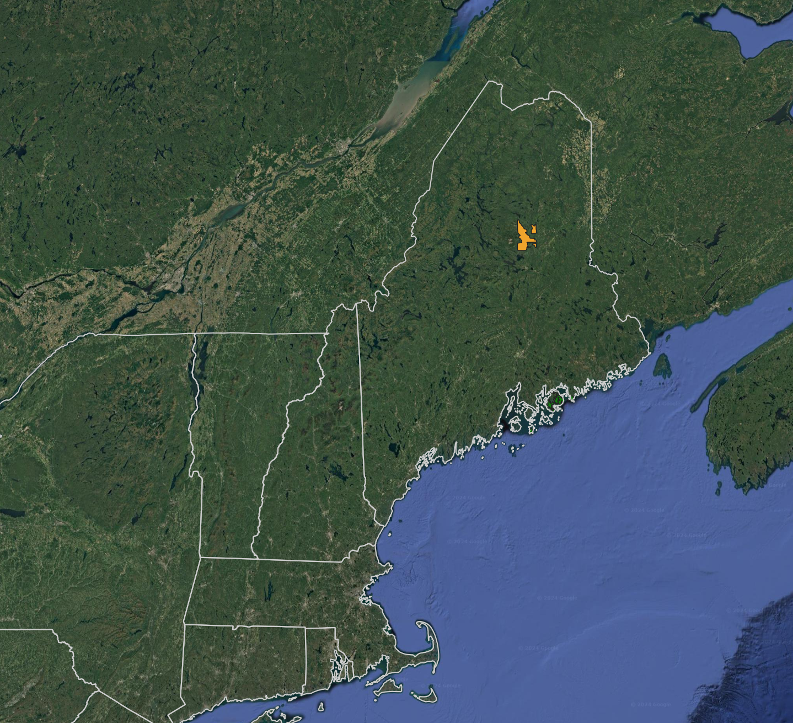
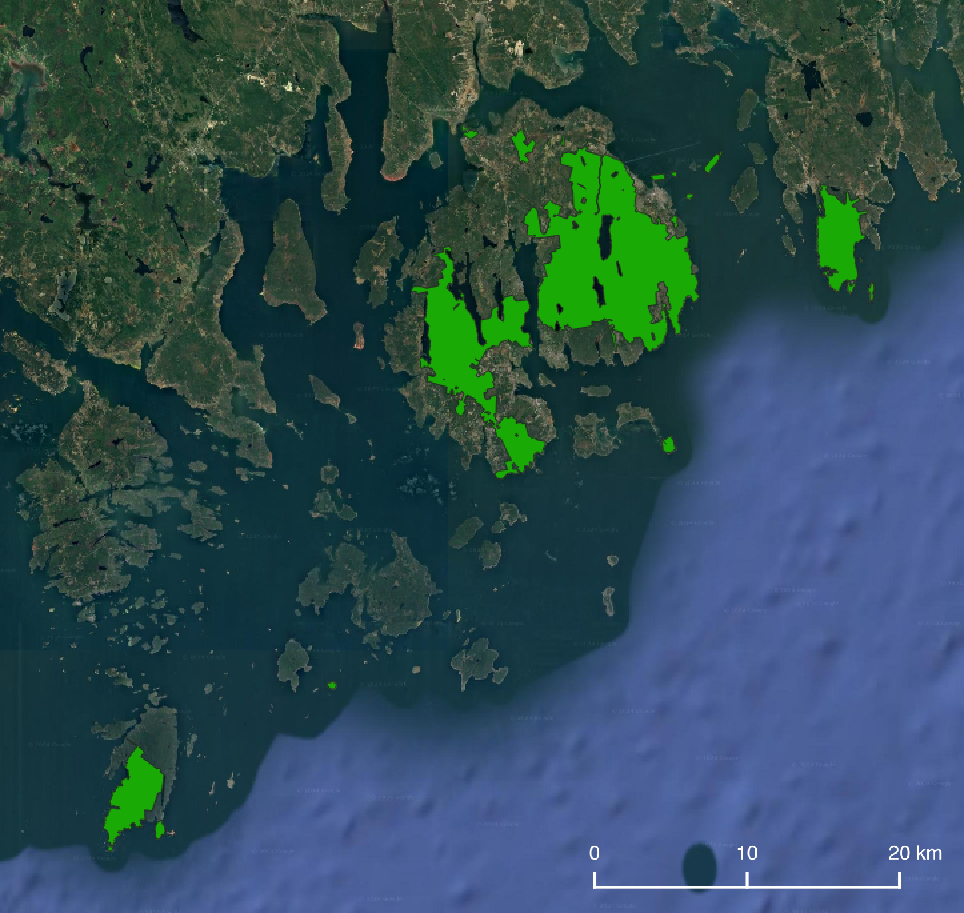
Katahdin Woods and Waters National
Monument
Canada
United States
New Brunswick
Acadia National Park
Quebec
Maine
New Hampshire

Slide 2
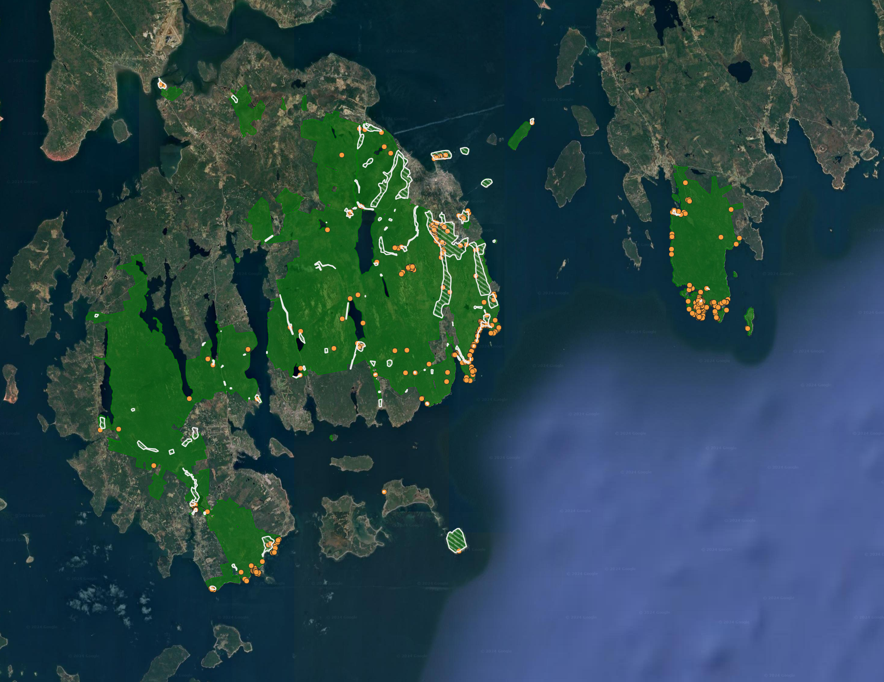
Acadia National Park
Invasive plant management areas
Invasive plant locations

